Slide 1

PART 1 : DC ANALYSIS
Chapter 1 Basic Concept
2022.1

Slide 2
Chapter 1 Basic Concept
1.1 Charge and Current
1.2 Voltage
1.3 Passive sign convention
1.4 Power and Energy
1.5 Sources
Summary and Review

Slide 3
Review
i
i
＋
A
B
U
A
A
B
B
The current has two factors:
value, reference direction
－
If i>0, reference direction and real direction
are the same.
If i<0, reference direction and real direction
are the opposite.
For A: Active sign convention
Non-associate Reference Direction
For B: Passive sign convention
Associate Reference Direction
u
–
+
A
B
The voltage has two factors:
value, reference direction
If u>0, reference direction and real direction
are the same.
If u<0, reference direction and real direction
are the opposite.

Slide 4

Fill the blank(s)
Points: 2
For circuit element A and B, try to decide the relationship between voltage and current reference direction. (Please fill in 1 for active sign convention, and fill in 2 for passive sign convention)
For element A: [填空1]
For element B: [填空2]
i
－
A
A
B
U
B
＋
正常使用填空题需3.0以上版本雨课堂
作答

Slide 5

1.4 Power and Energy
Power is the time rate of expending or absorbing energy, measured in watts.
We write this relationship as
Where p is power in watts (W), w is energy in joules (J), and t is time in second (s).
The power p is a time-varying quantity and is called the instantaneous power.

Slide 6
Current direction and voltage polarity play a major role in determining the sign of power.
passive sign convention
Active sign convention
i
i
+
+
u
v
u
–
–
Absorbing power
p= +ui
Absorbing power
p = -ui
p>0: the element absorbs energy ctually
p<0:the element supplys energy actually
Power absorbed=-Power supplied

Slide 7

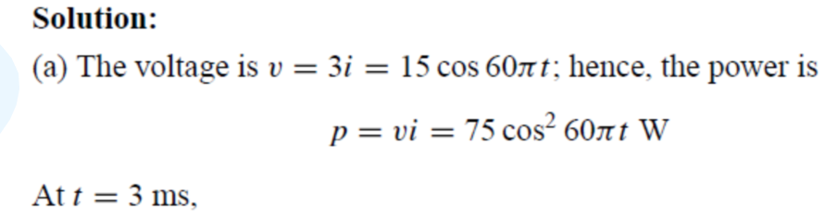
EXAMPLE 1.3

Slide 8
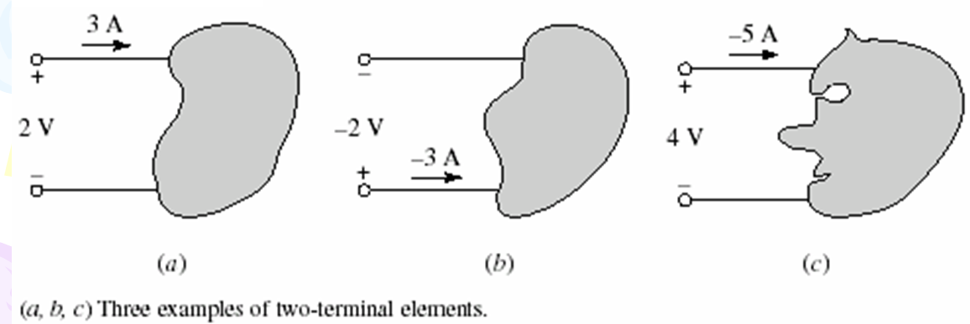
EXAMPLE 1.4
Compute the power absorbed by each part in Fig. 1.8.
Solution：
(a) Active sign convention: P =-(2 V) (3 A) = -6 W>0 Supply energy actually
(b) Passive sign convention: P = (-2 V) (-3 A) = 6 W>0 Absorb energy actually
(c) Passive sign convention: P = (4 V) (-5 A) = -20 W>0 supply energy actually
8

Slide 9
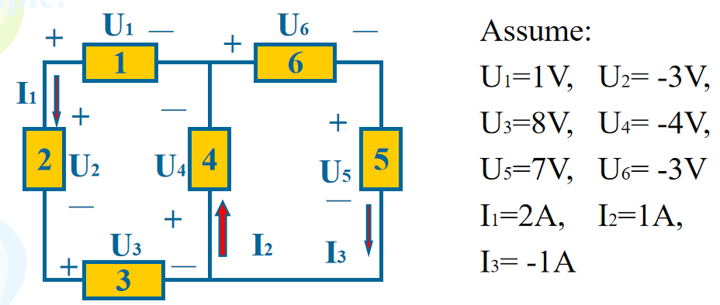
Fill the blank(s)
Points: 6
Please calculate the absorded energy for each element.
Answer:
Element 1: [填空1] Element 2: [填空2]
Element 3: [填空3] Element 4: [填空4]
Element 5: [填空5] Element 6: [填空6]
正常使用填空题需3.0以上版本雨课堂
作答

Slide 10
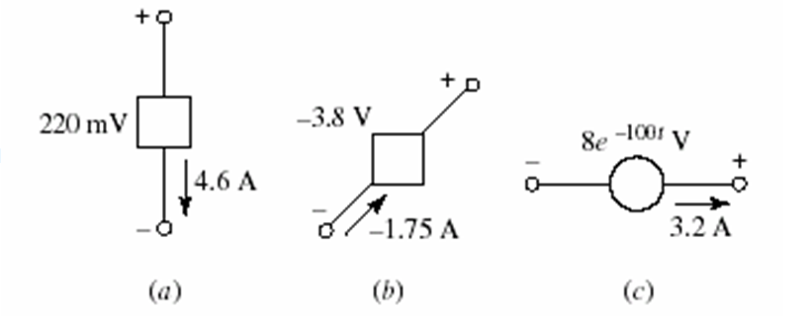
Fill the blank(s)
Points: 3
1. The power being absorbed by the circuit element in Fig.a is [填空1] W.
2. The power being generated by the circuit element in Fig.b is [填空2] W.
3. The power being delivered to the circuit element in Fig.c at t = 5 ms is [填空3] W.
-15.53
正常使用填空题需3.0以上版本雨课堂
作答

Slide 11
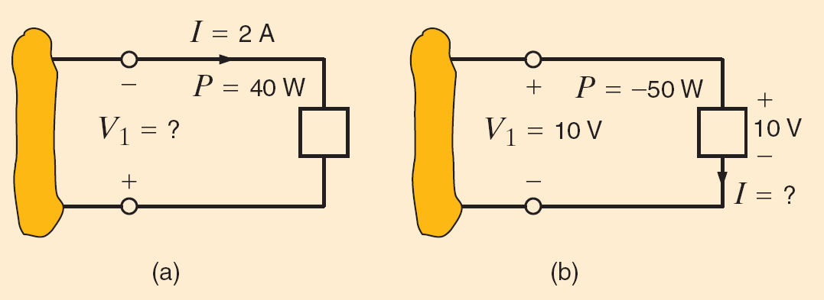
Practice : Determine the unknown variable in each circuit?
Circuit (a): V₁ = -20V
Circuit (b): I=-5A

Slide 12
Practice : Determine the unknown variable in each circuit?
Circuit (a): V₁ = -20V
Circuit (b): I=-5A

Slide 13
Summary
i
i
＋
A
B
U
A
A
B
B
The current has two factors:
value, reference direction
－
If i>0, reference direction and real direction
are the same.
If i<0, reference direction and real direction
are the opposite.
For A: Active sign convention
Non-associate Reference Direction
For B: Passive sign convention
Associate Reference Direction
u
–
+
A
B
Absorbing power
The voltage has two factors:
value, reference direction
For A:
P = -vi
If u>0, reference direction and real direction
are the same.
If u<0, reference direction and real direction
are the opposite.
For B:
P = vi
For an element:
Supplying power=-Absorbing power

Slide 14
1.5 Sources
An electric circuit is simply an interconnection of the elements.
For each element, its definition is based on its voltage-current
relationship. (u-i relationship, symbol)
Notice: In this course, elements are ideal elements or elements model, not real elements.
There are two types of elements found in electric circuits:
Passive elements: An passive element is not capable of generating energy. Such as resistors, capacitors, and inductors.
Active elements: An active element is capable of generating energy. Such as generators, batteries, and operational amplifiers.

Slide 15
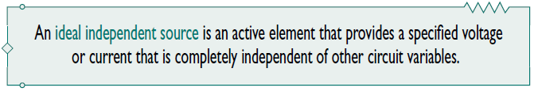
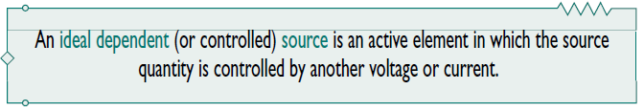
The most important active elements are voltage or current sources that generally deliver power to the circuit connected to them.
There are two kinds of sources: independent sources and dependent sources.

Slide 16
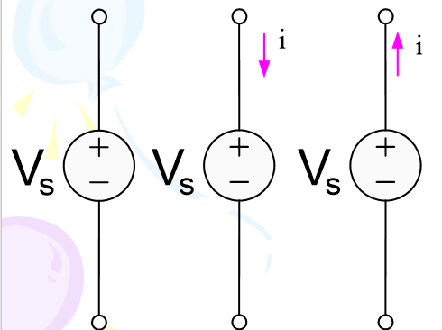
Independent Voltage Sources
The first element we will consider is the independent voltage source.
Circuit symbol
An independent voltage source is characterized by a terminal voltage which is completely independent of the current through it.
i
V_{s}
u
Factors of a Voltage Source: circuit symbol, value and reference direction.

Slide 17
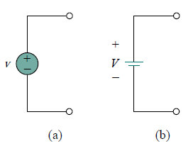
Both symbols in Fig. (a) and (b) can be used to represent a dc voltage source,
but only the symbol in Fig. (a) can be used for a time-varying voltage source.

Slide 18
Independent Current Sources
+
i
Another ideal source which we will need is the independent current source.
Circuit symbol is shown in Fig.13
The current through the element is completely independent of the voltage across it.
u
-
i
i_{s}
u
Factors of a Current Source: circuit symbol, value and reference direction.

Slide 19
Dependent (controlled) Sources
The source quantity of dependent sources is determined by a voltage or current existing at some other location in the system being analyzed.
There are four kind of Controlled Sources, that is,
current-controlled current source, CCCS;
voltage-controlled current source, VCCS;
voltage-controlled voltage source, VCVS;
current-controlled voltage source, CCVS .
Circuit Symbols is shown in Fig.1.14(a)

Slide 20
diamond-shaped symbols
gv_{x}
Kv_{x}
ri_{x}
Ki_{x}
(a)
(b)
(c)
(d)
Figure 1.14(a) The four different types of dependent sources:
current-controlled current source;
voltage-controlled current source;
voltage-controlled voltage source;
current-controlled voltage source.

Slide 21
gv_{x}
Kv_{x}
ri_{x}
Ki_{x}
(a)
(b)
(c)
(d)
The key idea to keep in mind is that a voltage source comes with polarities (+ −) in its symbol, while a current source comes with an arrow, irrespective of what it depends on.
Dependent sources are useful in modeling elements such as transistors, operational amplifiers and integrated circuits.

Slide 22
Fill the blank(s)
Points: 4
Determine the type of dependent sources.
Element a: [填空1] Element b: [填空2]
Element c: [填空3] Element d: [填空4]
gv_{x}
Kv_{x}
ri_{x}
Ki_{x}
(a)
(b)
(c)
(d)
正常使用填空题需3.0以上版本雨课堂
作答

Slide 23
The voltage 10i of the voltage source depends on the current i through element C.

Slide 24
The most important elements in this book
Passive elements
Resistors
Inductors
Capacitors
Independent voltage source
Independent source
Independent current source
Active
elements
CCCS
CCVS
VCVS
VCCS
Dependent source

Slide 25
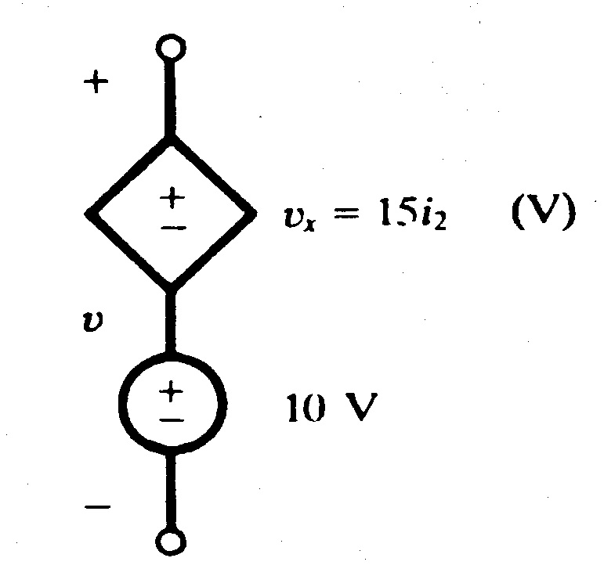

When dependent sources are given, their controlling current i_{x} and the controlling voltage v_{x} must be defined in the circuit.
Example
Obtain the voltage v in the branch
shown in Figure 1.15 for i2 = 1A.
Practice:
if i2 = 1A, v = ?
Figure 1.15
v = 10 + v_{x} = 10 + 15(1) = 25 V

Slide 26
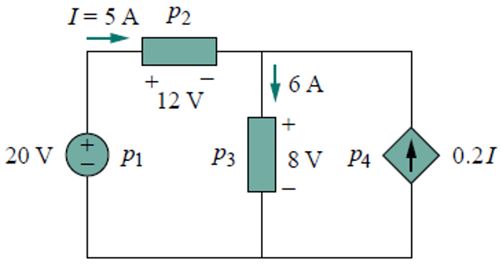

Example
Solution:

Slide 27
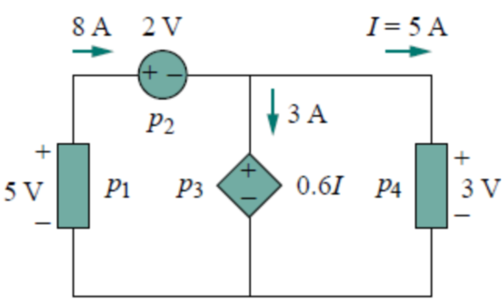
填空题
4分
Find the power absorbed by each element in the circuit.
p₁= [填空1]W p₂= [填空2]W
p₃= [填空3]W p₄= [填空4]W
正常使用填空题需3.0以上版本雨课堂
作答

Slide 28
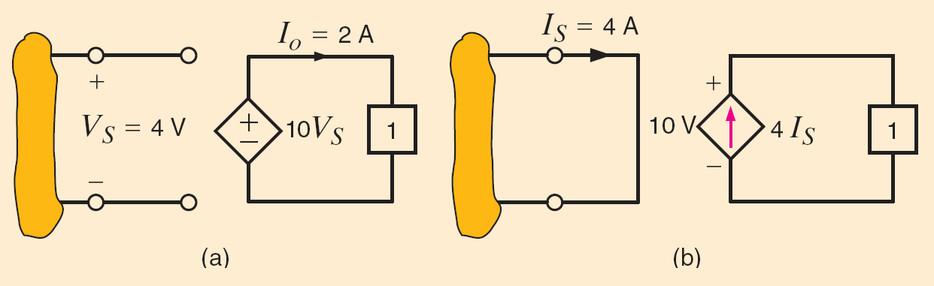
Determine the power supplied by the dependent sources
Practice

Slide 29
SUMMARY OF CHAPTER 1
1. Circuit variables
Current Amp
Charge Coulombs
Voltage Volts
2. Power Watts

Slide 30
SUMMARY OF CHAPTER 1
3. Circuit elements
① Independent sources
Independent voltage source
Independent current source
30

Slide 31
SUMMARY OF CHAPTER 1
② Dependent sources
gv_{x}
Kv_{x}
ri_{x}
Ki_{x}
(a)
(b)
(c)
(d)
31

Slide 32
The most important elements in this book
Passive elements
Resistors
Inductors
Capacitors
Independent voltage source
Independent source
Independent current source
Active
elements
CCCS
CCVS
VCVS
VCCS
Dependent source

Slide 33
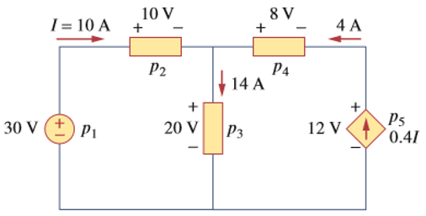
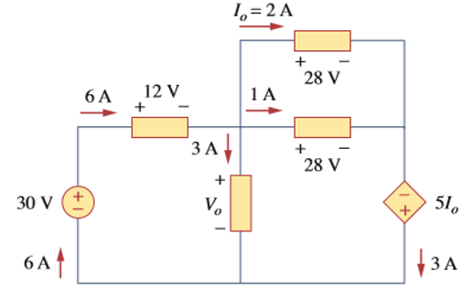
Homework （2th time）
1. Find the power absorbed by each of the elementd in Figure 1.
Figure 1
2. Find V₀ and the power absorbed by each of the element in Figure 2.
Figure 2

